Slide 1

Digital Standards and Bringing it together
May 2, 2019 – Kayle Hatt, TBS Office of the Chief Information Officer

Slide 2





Why “Digital”? / About me
Recapping the Digital Standards
Designing Ethical Services
Bringing it Together Exercise

Slide 3

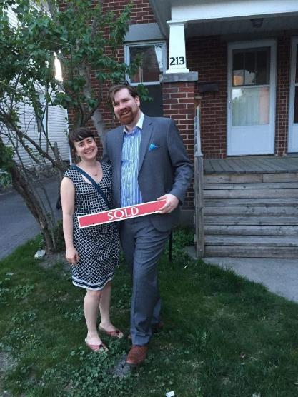


Why “Digital”? / About me

Slide 4
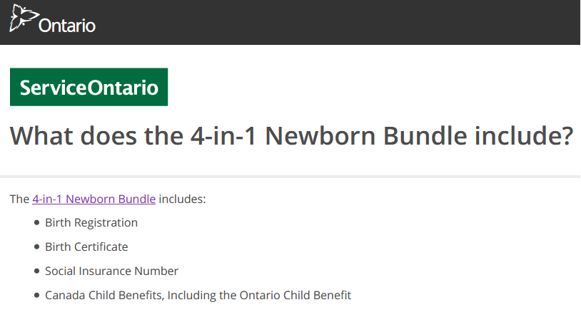
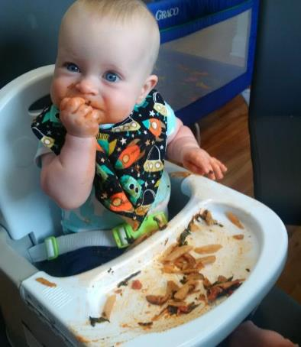
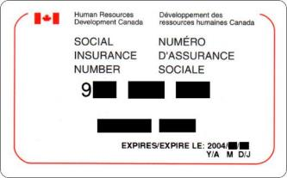
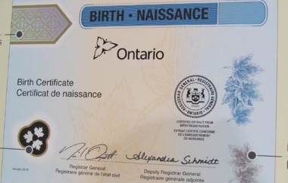
Why “Digital”? / About me

Slide 5

Recapping the Digital Standards

Slide 6










Government of Canada Digital Standards
Build in accessibility from the start
Design with users
Iterate and improve frequently
Empower staff to deliver better services
Work in the open by default
Be good data stewards
Use open standards and solutions
Design ethical services
Address security and privacy risks
Collaborate widely
Notes:
Icon source - https://material.io/tools/icons/?icon=visibility&style=outline

Slide 7

Recapping the Digital Standards
Activity: Do you know it well enough to explain it?
In groups of 2 (or 3), you will be randomly assigned a Digital Standard and given 10 minutes to develop a short explanation of the standard based on what you’ve learned about it in the course or from their personal experience encountering this standard in their work.
Prepare as if you are discussing it at your work or in a future project team.
Groups will present explanations in rotating order, for about 2-3 minutes each and answer questions from your colleagues.

Slide 8


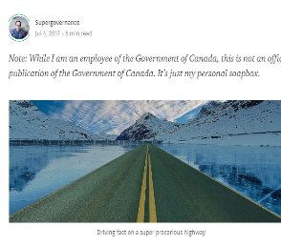

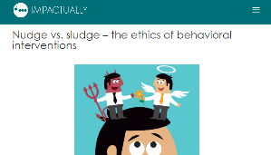
Designing Ethical Services
Pre-readings:
Responsible AI in the Government of Canada: a Sneak Peek, by Michael Karlin
The Code I’m still ashamed of, by Bill Sourour.
A Child Abuse Prediction Model Fails Poor Families, by Virginia Eubanks (excerpt from Automating Inequality)
Nudge versus Sludge: the ethics of Behavioral interventions, by Nurit Nobel
Discussion:
The Values and Ethics Code of the Public Service applies to everything we do.
In addition, the Design Ethical Services says: “Make sure that everyone receives fair treatment. Comply with ethical guidelines in the design and use of systems which automate decision making (such as the use of artificial intelligence).”
How else can Design Ethical Services be interpreted?
What did you think about the pre-readings?
Have you ever had to deal with an ethical issue or a situation that got into ethical grey areas?
How do you navigate ethical issues? What lenses can you use?
What mechanisms can you use to address these issues?

Slide 9

Bringing it Together Exercise
Activity: The Digital Standards in Practice
In a mock activity, participants are asked to provide advice to potential projects based on what you’ve learned in the course.
In this scenario, you work in a departmental digital project team and a new project has been proposed. Senior leaders are interested in the idea but want a second opinion before proceeding with implementation.
In groups of 5 or 6, discuss the case and consider:
What additional information is needed? What questions would you ask about the project?
What would be your recommendations and advice for the project?
Midway through the session, you will have an short opportunity to ask clarifying questions from the facilitator similar to an interview with the client or project proposer.

Slide 10
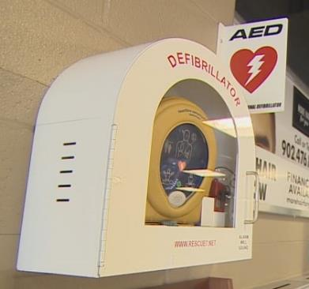
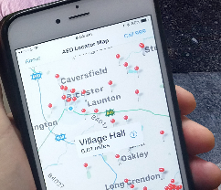
Case 1: An APP for finding AED and Saving Lives!
Overview Description:
Problem:
In Canada, 35,000 to 45,000 people die of sudden cardiac arrest (SCA) each year.
An automated external defibrillator or AED uses electric shocks to restart a heart after cardiac arrest, and can save lives.
Without intervention in the first 10 minutes, the survival rate of SCA is only 5%; with use of AED in the first minute after an incident the survival rate can be as high as 90%, but it declines 7-10% every additional minute that passes. Given the importance of quick response and how long it can take for an ambulance to arrive, AEDs have been installed in many public places.
But they can only work if bystanders know exactly where AEDs are in an emergency.
Proposal:
We will develop an app that uses smartphone geolocation (GPS) to direct bystanders to the nearest AED; it will also display a graphic on how to use them.
Data for the locations will be provided from an annual inventory done by local health agencies.
Usability testing will be used to make the app user-friendly.

Slide 11
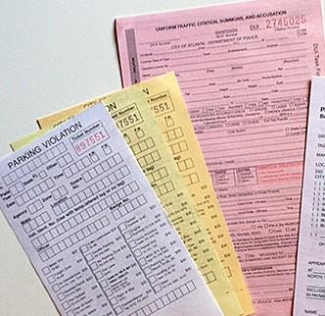
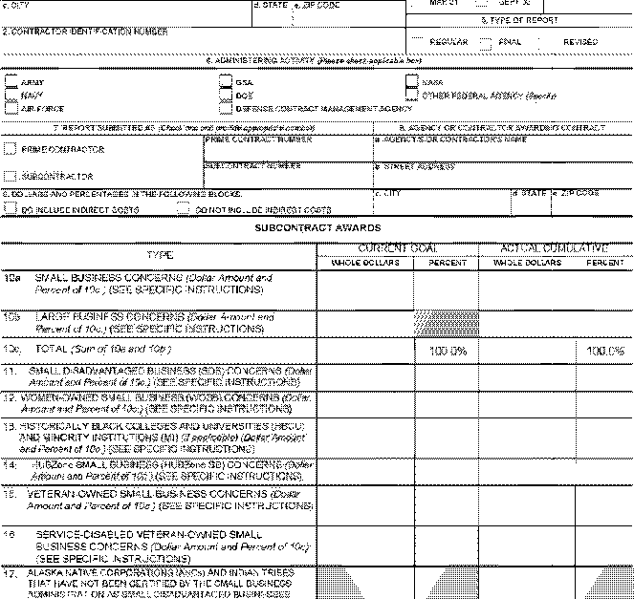

Case 2: Allowing electronic submissions of regulatory forms
Overview Description:
Problem:
Department XYZ regulates an industry that involves a large number of businesses, including small and large enterprises.
The regulated industry is required to submit reports about the safety of their products, production reports and incident reporting when a problem has been identified. Even for small businesses this often means a few reports a month; for larger businesses, it means several a day.
A couple years ago, the department made this process easier through the creation online fillable PDF forms where text can be entered electronically and printed for signature.
However, currently, all of these reports are required to be sent through the mail or by fax to the regulator, which can result in delays for notifications. Additionally, some members of the regulated industry have told the department that “the only reason we have fax machines are to communicate with government.”
Proposal:
We will develop a portal where businesses can submit scans of reports to the regulator.
The portal will have a secure sign-in feature, verified by mailing a log-in code to regulated industries.

Slide 12
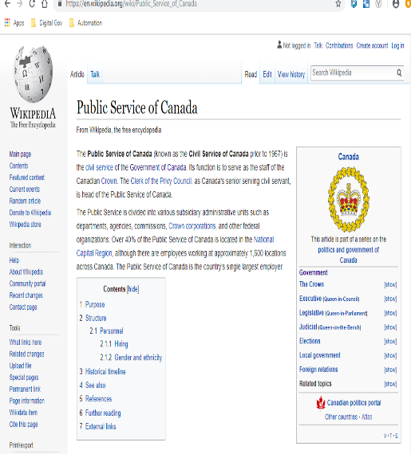
Case 3: Online wiki-style website with program information to help service applicants
Overview Description:
Problem:
Department XYZ provides various services to Canadians and businesses in a variety of policy areas.
The department frequently gets emails or phone calls asking for more information about the services, eligibility, how to apply, or answering basic questions.
These inquiries can take a lot of resources to answer questions when, often, the information is available elsewhere. This has resulted in large queues in email correspondence and overloaded departmental call centres.
Proposal:
We will develop a new wiki-style website, using our service manual and back-office documentation as foundational content, but enabling employees to make edits to the content in the wiki.
The portal will help people better navigate the ins and outs of these various programs.
As a result of this project, we are predicting that we can reduce the budget for the correspondence / inquiries service by 10%, which will be staff managed by not fulling vacancies.

